Slide 1


LANGUAGE SCHOOL STARTUP PORTFOLIO WEBSITE
purpose, key features, and target audience.

Slide 2



INTRODUCTION
Language School
Community
We offer a diverse range of language courses designed to cater to the needs of individuals and businesses.
We are a welcoming community of language enthusiasts, dedicated to helping you achieve your linguistic goals.
Join our vibrant language school community and take the first step towards mastering a new language.

Slide 3

OUR MISSION
At our organization, we are dedicated to providing high-quality language education that empowers individuals to communicate effectively across cultural boundaries. Our mission is to foster a deeper understanding and appreciation of diverse cultures, promoting global connectivity and cultural exchange.

Slide 4




OUR APPROACH
Innovative Teaching Methods
Personalized Learning
Diverse Curriculum
We employ a range of innovative teaching techniques, including interactive discussions, hands-on projects, and the incorporation of cutting-edge technologies, to engage students and promote active learning.
Our personalized learning approach allows us to tailor the curriculum and learning experiences to the unique needs, interests, and abilities of each student, ensuring they reach their full potential.
We offer a diverse curriculum that encompasses a wide range of subjects, from traditional core disciplines to emerging fields, providing students with a well-rounded education and the opportunity to explore their passions.

Slide 5

MEET THE TEAM
.....................
.................
....................
.................
...............
French Language Instructor
Japanese Language Instructor
Spanish Language Instructor
Irish Language Instructor
Mandarin Language Instructor

Slide 6



COURSE OFFERINGS
Language
Proficiency Level
Spanish
Beginner, Intermediate, Advanced
French
Beginner, Intermediate, Advanced
*Language Course Offerings, ABC Language School (2023)

Slide 7
“THE COURSE CONTENT WAS INCREDIBLY ENGAGING, AND THE INSTRUCTOR'S TEACHING STYLE MADE THE MATERIAL ACCESSIBLE AND EASY TO UNDERSTAND. I FEEL MUCH MORE CONFIDENT IN MY ABILITY TO APPLY WHAT I'VE LEARNED TO REAL-WORLD SITUATIONS.”
EMILY WILKINS

Slide 8


Slide 9

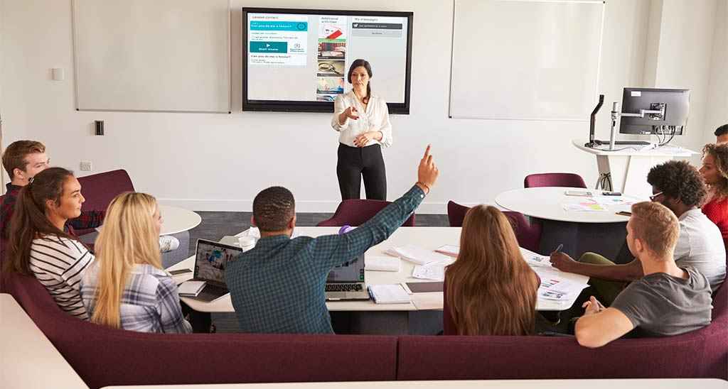
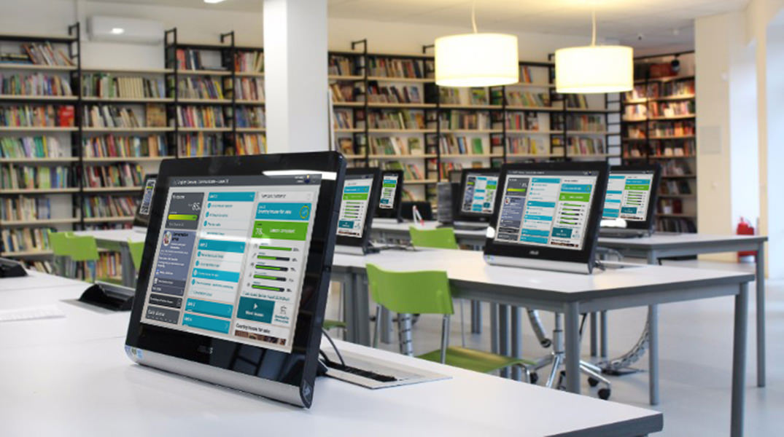

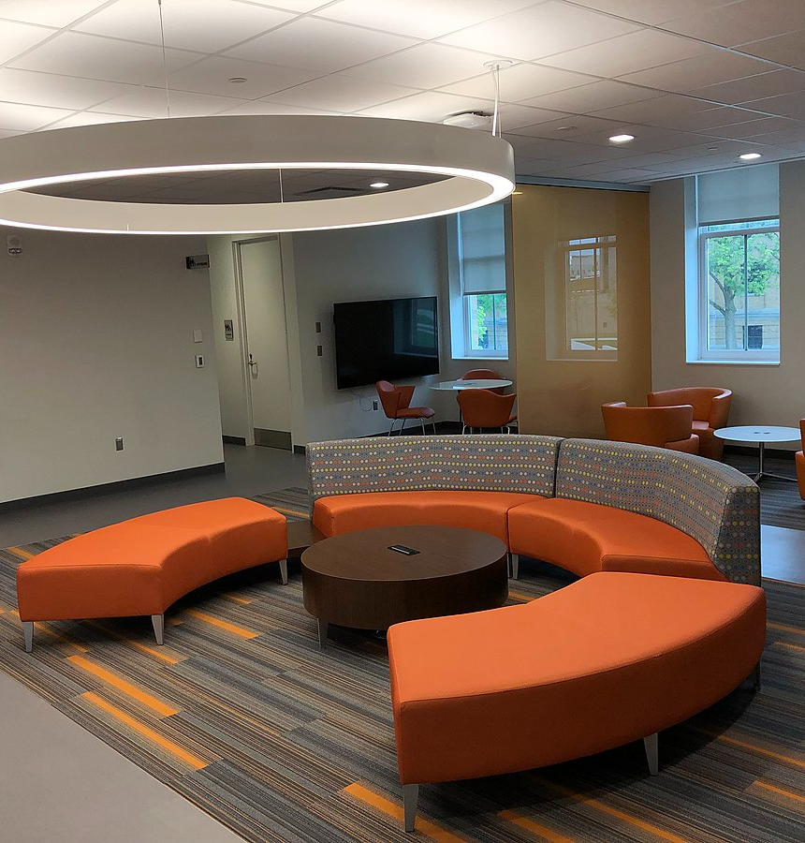
FACILITIES AND RESOURCES
Spacious Classrooms
Language Lab
Multimedia Library
Student Lounge
Our modern classrooms are equipped with ample seating, large whiteboards, and state-of-the-art audio-visual equipment to create an optimal learning environment.
The dedicated language lab features individual workstations with computers, headsets, and specialized language learning software to provide a immersive digital learning experience.
Our well-stocked multimedia library offers a vast collection of foreign language books, audiobooks, movies, and other educational resources to supplement classroom instruction.
The student lounge provides a comfortable space for learners to collaborate, practice conversations, and engage in extracurricular language-related activities.

